Slide 1

Analysis of crimes in the USA
Project work
Ciavarro Cristina 253188
Di Natale Marco 255660

Slide 2

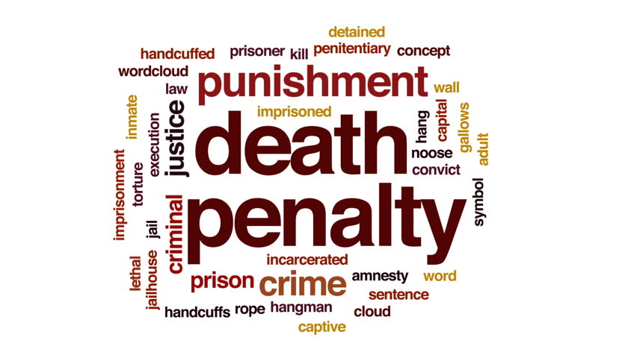
Introduction: why this data?
In summary our curiosity of choosing this dataset was as a result of the
different penalty in
USA carried out by
American justice in
relation to different
crimes.

Slide 3
Description of data set
The first data set type we have used is available from the official website of the FBI.
In this website data are available year by year in csv files, and every year has different types of data sets that contain different information.
To do our studies we needed to download different types of data sets and then rebuild the data set useful for our purposes.

Slide 4
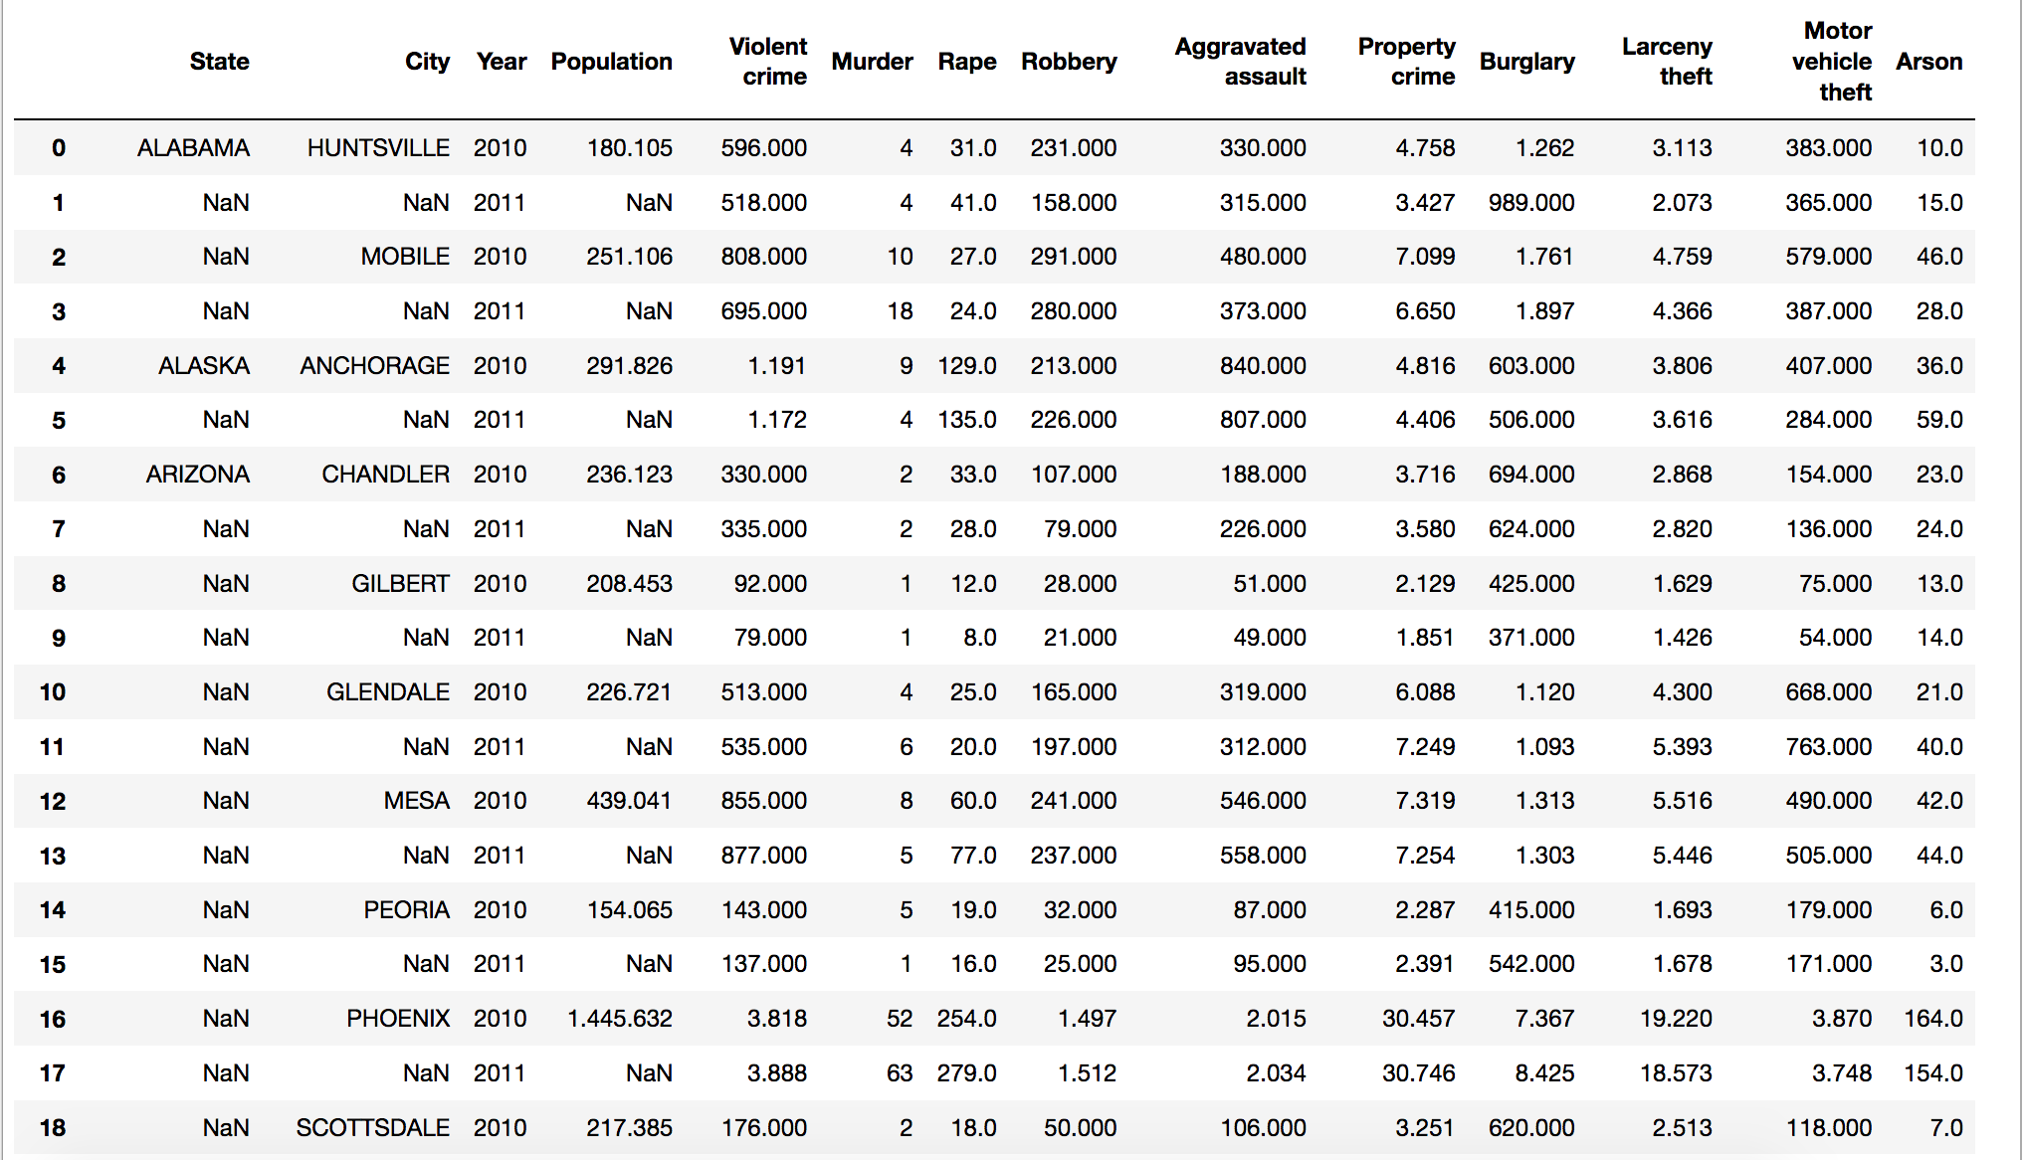
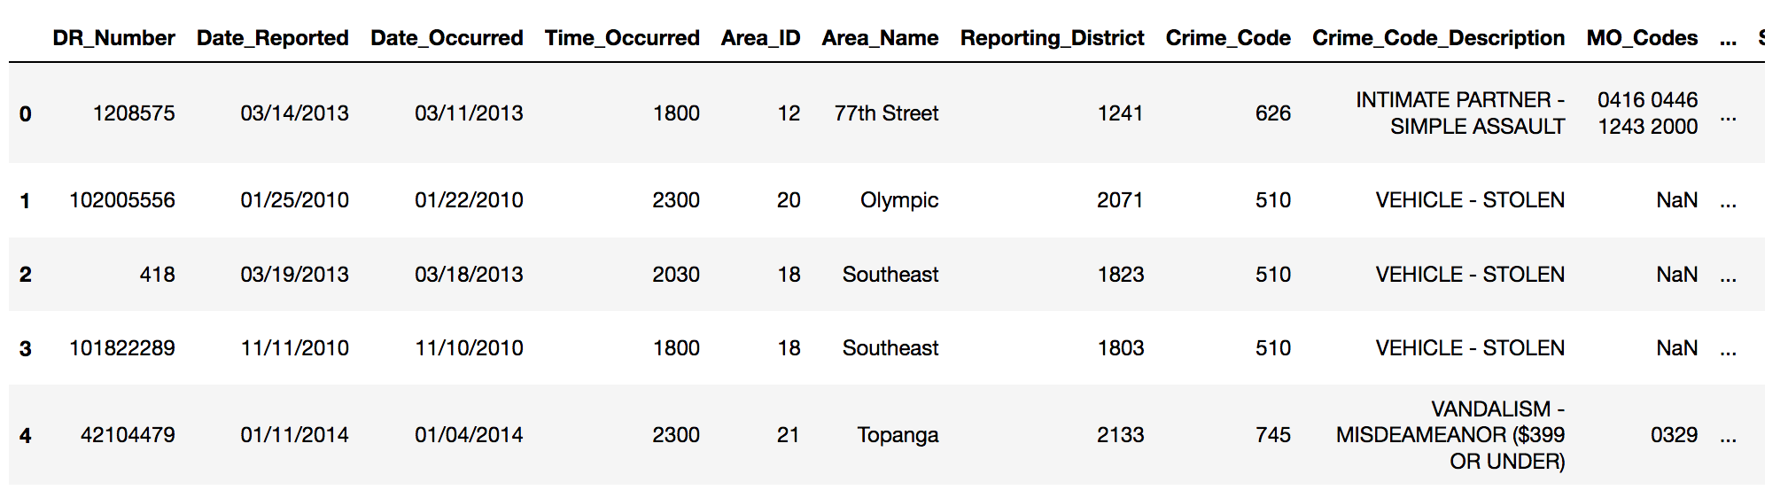

Description of data set
In particular we downloaded 9 data sets:
Data set of crimes in the USA: 7 data sets, downloaded by the FBI website, show the number of different crimes compared to American cities grouped according to the states they belong to.
(3582 rows and 14 columns)
Coordinate Data set: 1 data sets, containing the coordinates of the places we have to show in the USA map
Figure 1
Data set of crimes in Los Angeles: 1 data sets containing all the crimes that took place in Los Angeles in 2016.
(1584316 rows and 28 columns before cleaning, after cleaning with only crime occurred in 2016 rows are reduced to 20441 )
Figure 2

Slide 5
Data cleaning
We first created a single data set by combining the 7 Data set of crimes in the USA, where:
We have eliminated the row containing the FBI prediction for each of the seven data sets ( but we used FBI predictions for 2017 comparing them with ours),
We had to add the geographic coordinates data set for each state,
We had to fill the empty row in the State column with the name of the state to which the respective city in the next column belonged.
For NaNs in the crimes columns we use a logic,
We added the data of all the cities of each state, thus reporting information on crimes according to the States and no longer according to the cities.

Slide 6
Data cleaning
Figure 1

Slide 7
Data cleaning
For the second part it was necessary to download a new
Data set for crimes in Los Angeles, where we have done a reordering:
Because each line reports a crime with related information, we needed to take the different types of crimes located in each row making them the columns of this new data set
NaNs on this data set were present in a different way

Slide 8
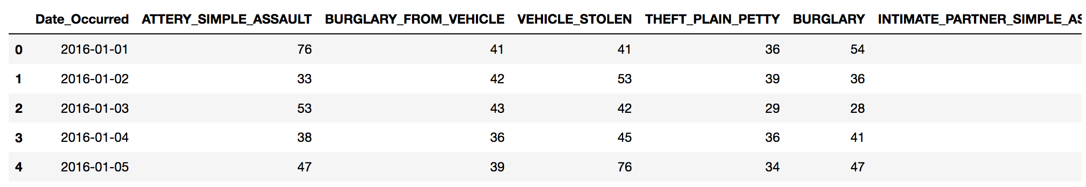
Data cleaning
Figure 2

Slide 9
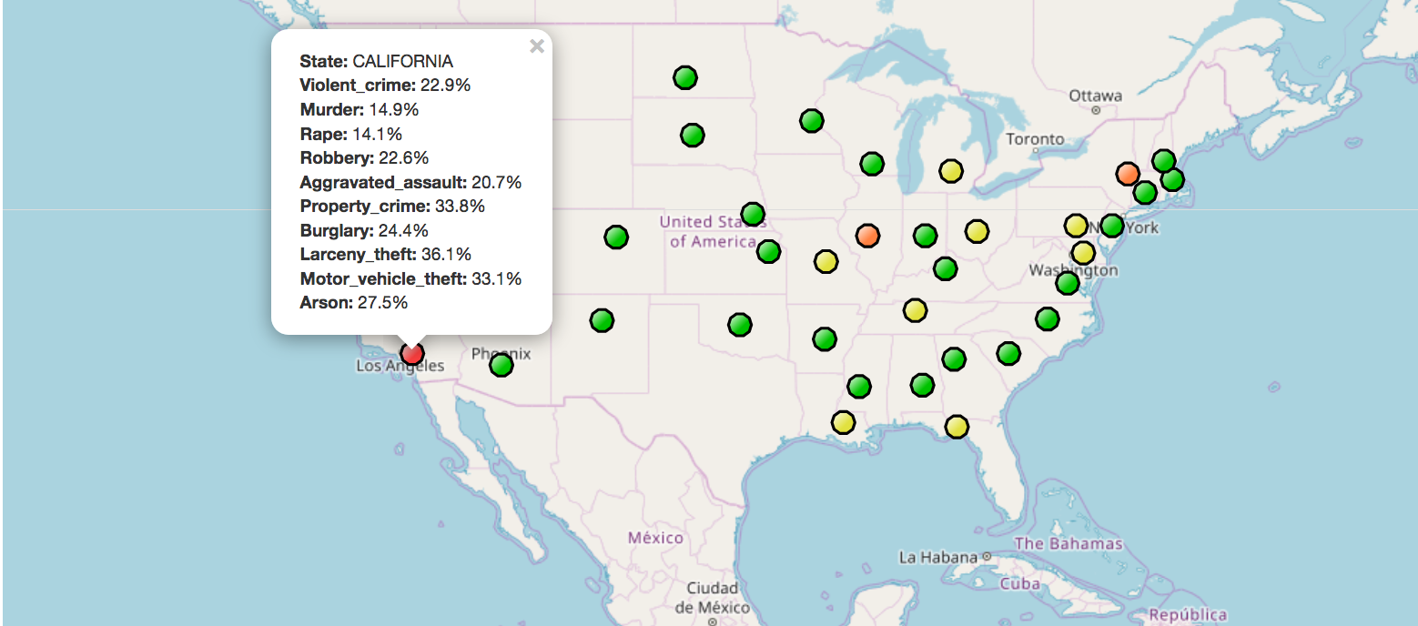
Exploratory analysis
Our study has moved according to a zoom: we started from the general situation of the United States and then concentrate on the most affected State in the crime rate (California), finally studying its most populous city (Los Angeles). The statically study we have done are as follow :
To calculate the mean values which shows the crime with the highest impact in USA

Slide 10
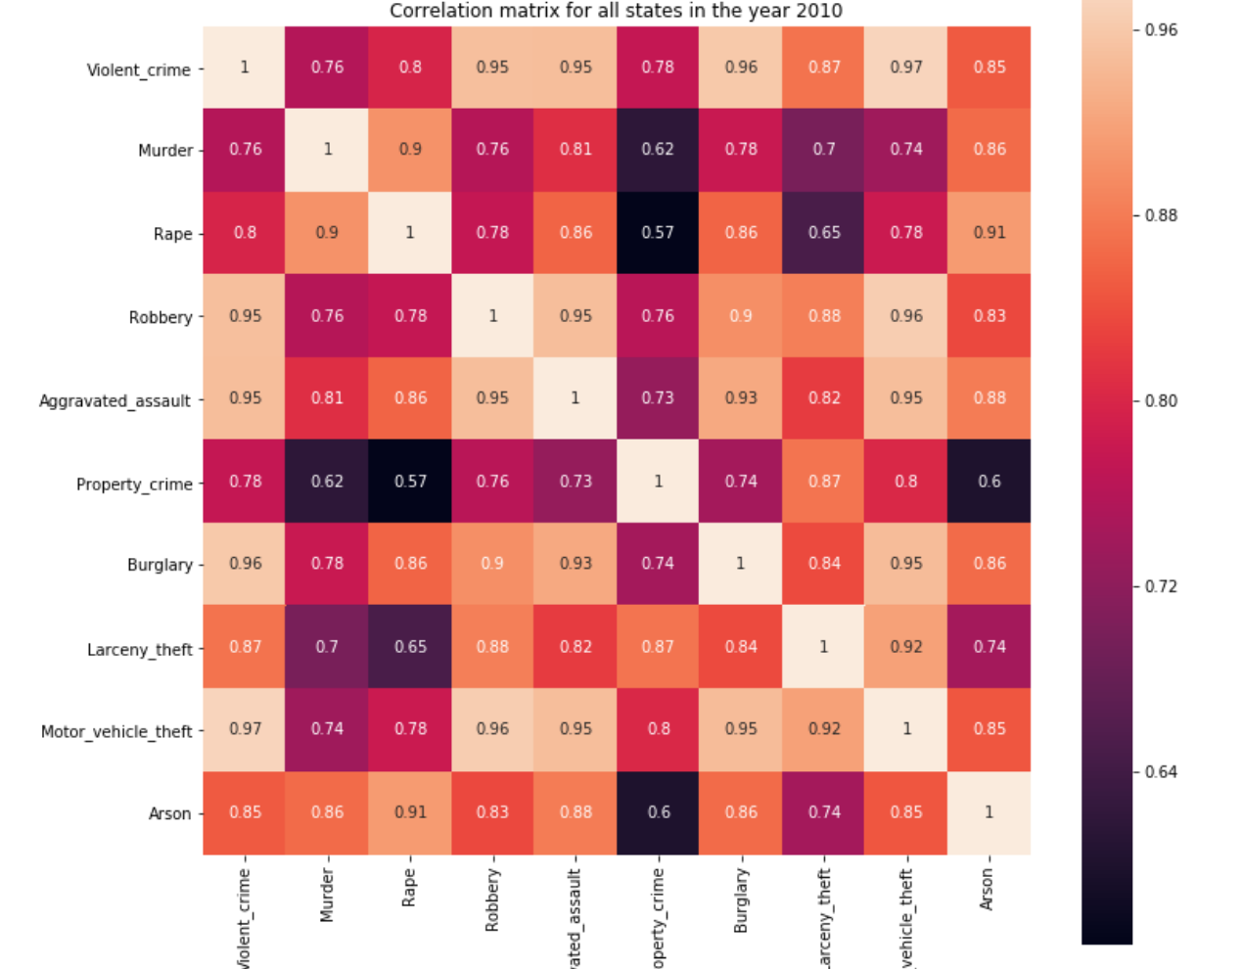
Exploratory analysis
The correlation matrix which shows how various crimes are related to each other. The crimes with a correlation value of more than 0.75 shows that the two crimes are strongly correlated that is the increase to one of the crime leads to the increase of the other crime and vice versa. This example shows the correlation matrix of crimes in America in the year 2010:
Scrivi per inserire una didascalia.

Slide 11
Exploratory analysis
To calculate the standard deviation which shows the spread of the crime over the years interval 2010-2016, with the following results:
The most frequent crime from 2010-2016 in Los Angeles is ARSON because it has the highest mean value and maximum frequency. In the considered year interval, our analysis reviewed that ARSON attained it's maximum occurrence in 2013 and minimum in 2015 in Los Angeles.
The crime BURGLARY has the lowest standard deviation this shows that the crime rate spread is close to the mean, that is, from 2010-2016, the rate of occurrence is close to each other.
The less frequent crime from 2010-2016 in Los Angeles is ROBBERY because it has the lowest mean value. In the considered year interval, our analysis reviewed that ROBBERY attained it's maximum occurrence in 2010 and minimum in 2014 in Los Angeles.
The crime, RAPE has the highest standard deviation this shows a high fluctuation of the crime between 2010 - 2016. According our analysis, from 2013 to 2016 Los Angeles experience a sharp decrease in RAPE, this may have resulted from FBI modification of the definition for RAPE and other RAPE related crimes have been classified in another category of crimes not contained in our dataset.

Slide 12
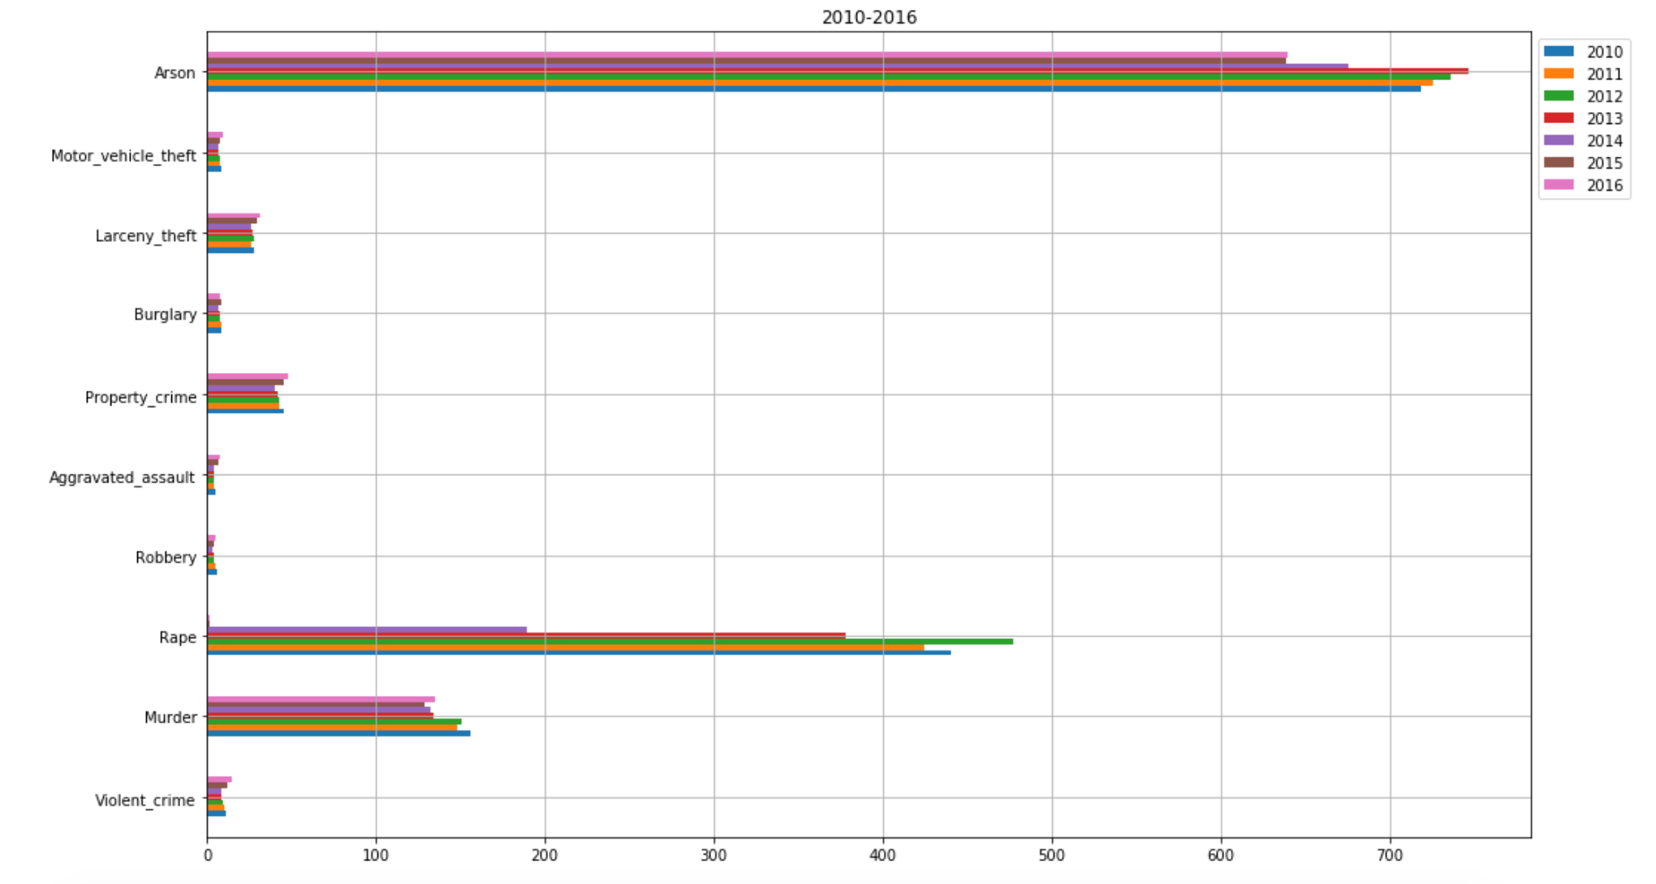
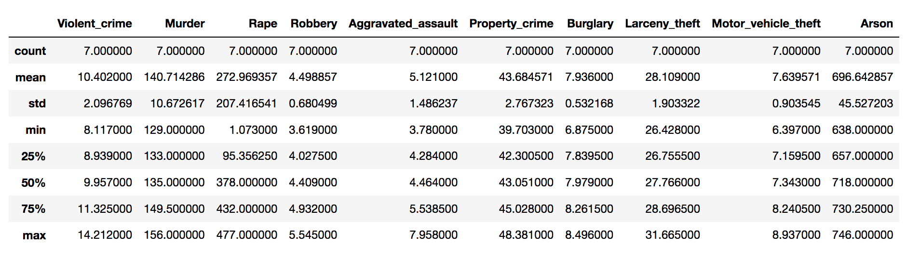
Exploratory analysis

Slide 13
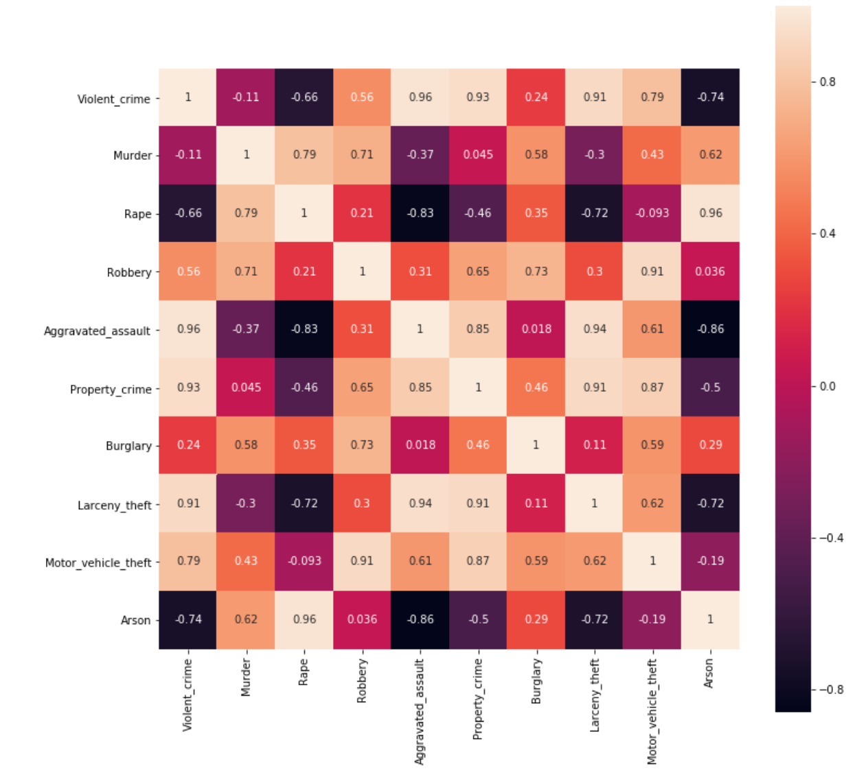
Exploratory analysis
This is the correlation matrix for Los Angeles crime between years 2010-2016 made with the first data set:

Slide 14
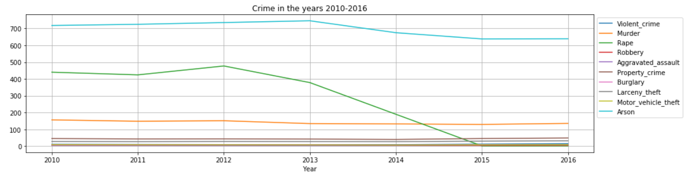
Exploratory analysis
We calculated the Line Plot graph which clearly shows the increase and decrease of crimes in the given year interval 2010-2016. In the following example we can see crimes in Los Angeles in the given year interval 2010-2016:

Slide 15
Unsupervised learning
For unsupervised learning we used the K-Means clustering algorithm.
Purpose : belongs to the family of moving centroid algorithms, i.e. at every iteration the center (or centroid) of the cluster moves slightly to minimize the objective function.
Results: this clustering could be used, in a more specific study, to :
understand how to arrange the police patrols in the city,
to organize the streets more subject to certain crimes in order to control those who attend them,
preventing crime,
limiting the damage of crimes.

Slide 16
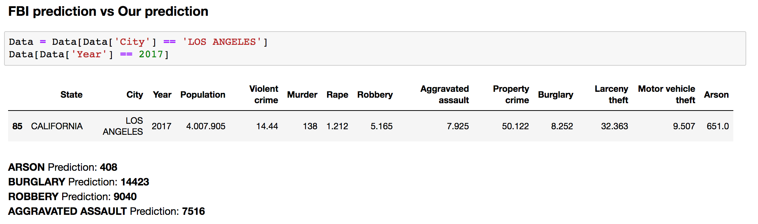
Supervised learning
Regression analysis is a form of predictive modelling technique which investigates the relationship between a dependent (target) and independent variable (s) (predictor). This technique is used for forecasting, time series modelling and finding the causal effect relationship between the variables.
For this, to predict crime in 2017, we applied various algorithm such as Regression algorithms, Regression Tree, Big Random Forest, Random Forest and Bagging.
As we have previously mentioned, we compared the results of our prediction with the prediction made by the FBI and we have had the following results:

Slide 17
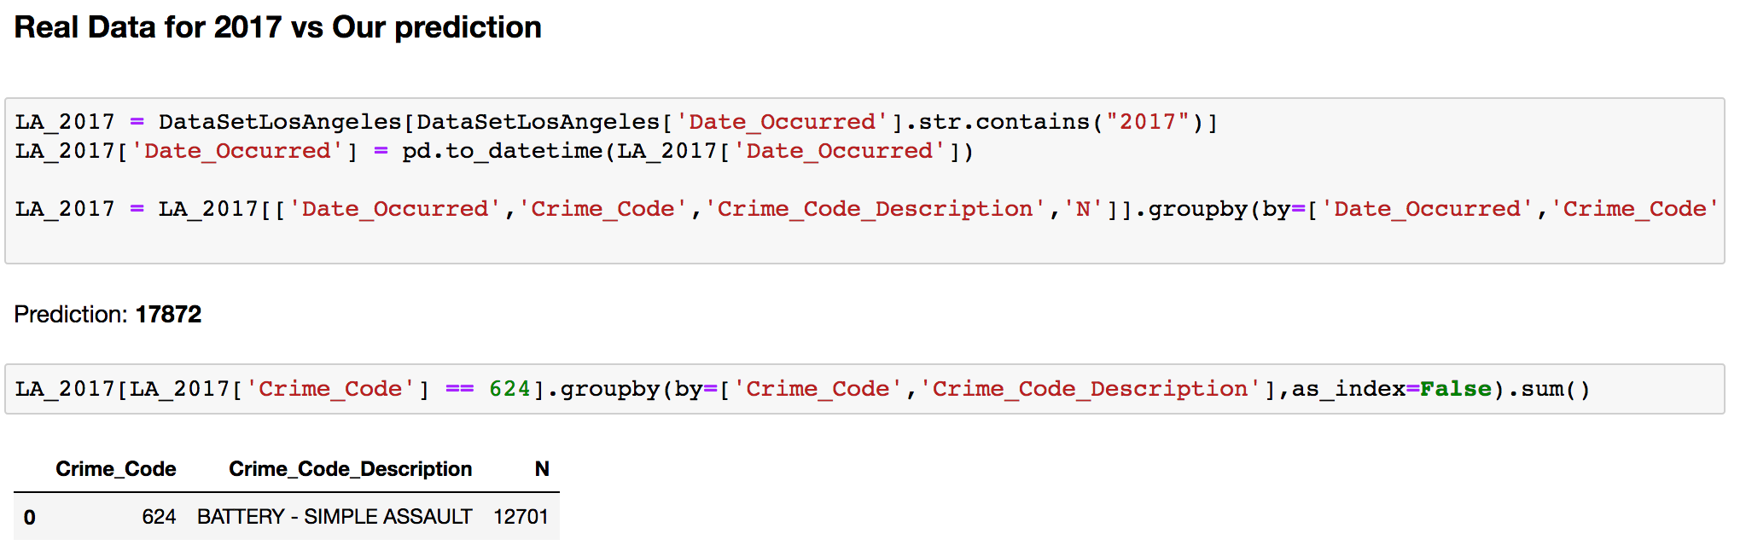
Supervised learning
Instead this is an example of result of the comparison of the real data concerning the crimes in 2017 in Los Angeles vs the prediction made by us for 2017.

Slide 18
Conclusion
Result : We were able to draw was that from our study, in reference to our Data Deceleration, in 2013 the FB1 UCR Program initiated the collection of rape data under a revised definition within the summary based Reporting System.
“The term Forcible was removed from the offense name, and the definition was changed to penetration this clearly explains why in our Old Dataset in general crimes rate reduced from 2013 -2016 ”.
Also there is a strong positive correlation between our new Data set and old Dataset which explains more why crime rates reduced from 2013-2016 , the new Dataset has many attributes which shows that many crimes has been redefined and this leads to a decrease in crime rate.
As we said in the introduction we wondered if in the USA the presence of the death penalty affected or not the crime rate. We found that in California and Texas were still active.
In particular in California the statute of the death penalty was contested constitutionally.
Texas is the state with the highest number of executions in the USA. In particular in 2015 the 86% of executions focused on Texas, Georgia and Missouri.
On 6 November 2012, California voted on the possible abolition of the death penalty, maintaining it with 52% of the vote and since 2013 many courts have suspended the application in California.
To date, Texas is considering adapting to the temporary suspension of the death penalty.

Slide 19
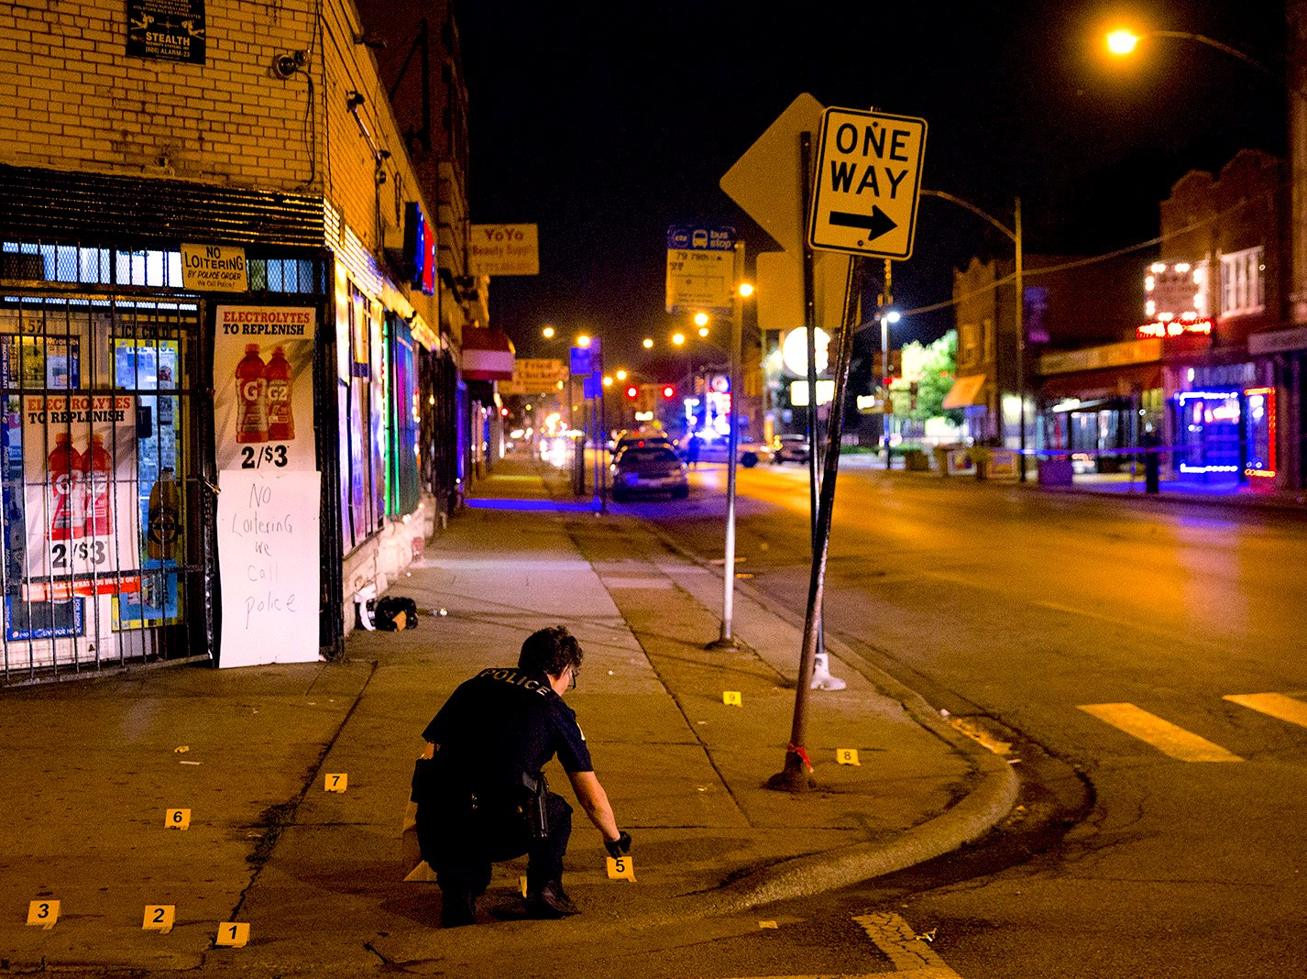

Grazie

